Slide 1
Compute and Connectivity (CCX)
Satya Simha
June 2017

Slide 2
StrataGX Processors

Slide 3
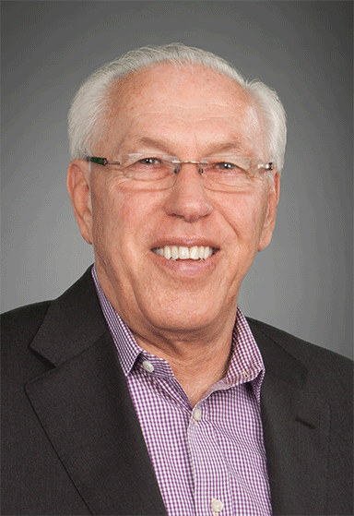
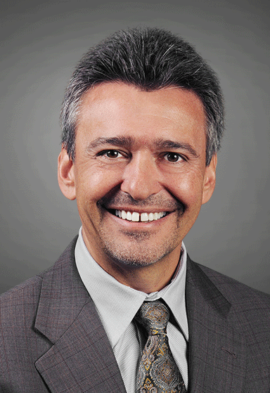


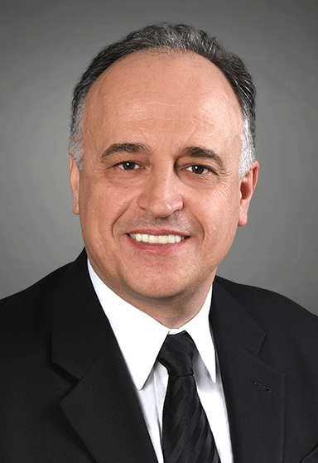
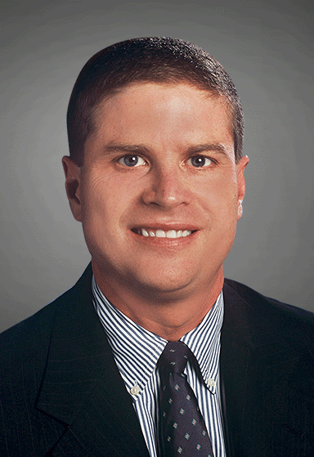
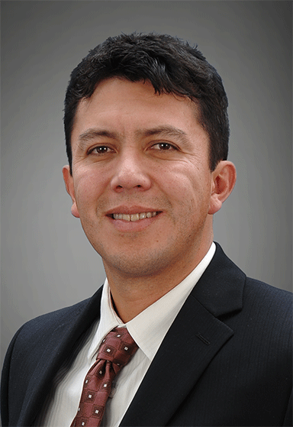

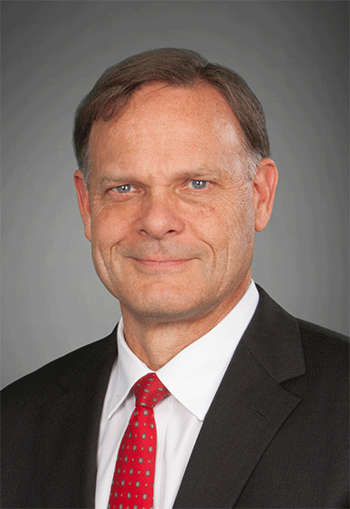
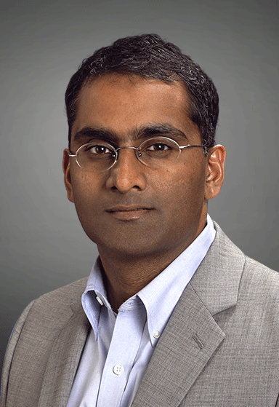
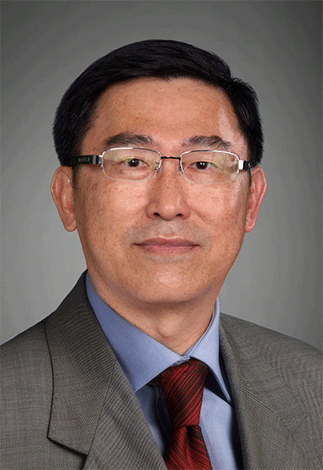
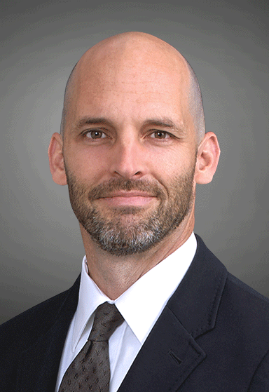
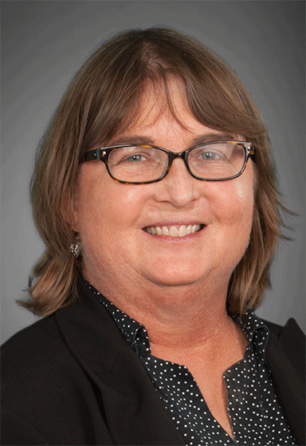
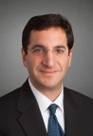
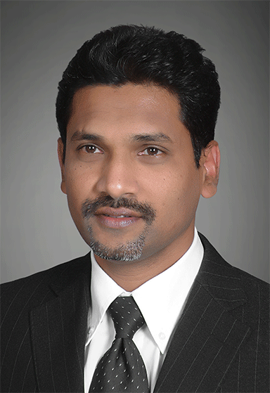

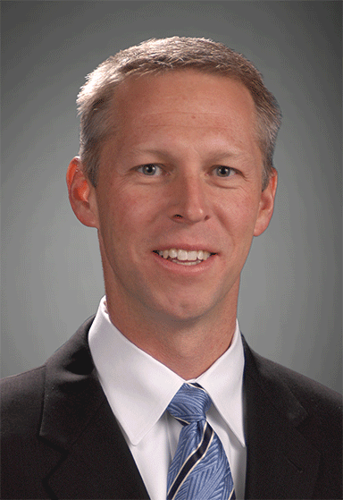
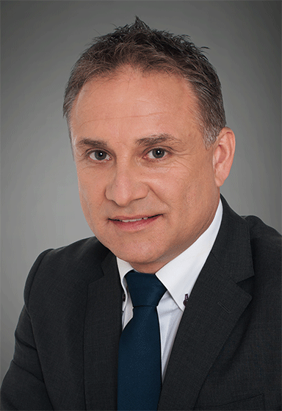
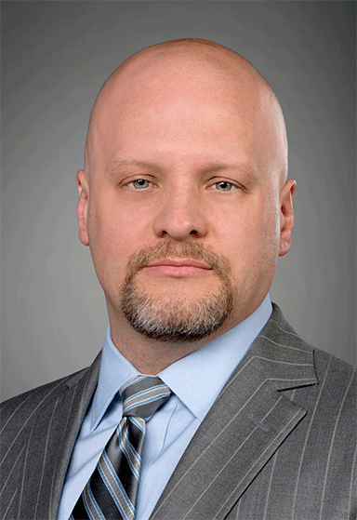
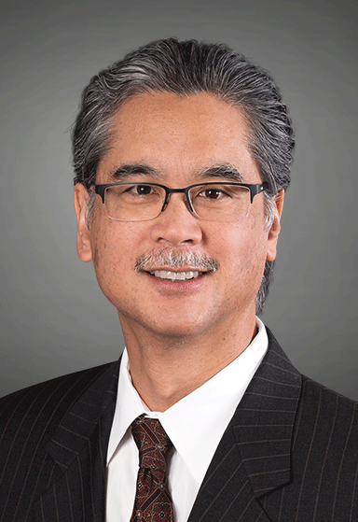
Division Leadership
Jim Bland SVP & GM, Data Controller | Greg Fischer SVP & GM, Broadband Carrier Access Products | Michael E. Hurlston SVP & GM, Mobile Connectivity Products
Bryan Ingram SVP & GM, Wireless Semiconductor | Lorenzo Longo SVP & GM, Physical Layer Products | Rich Nelson SVP & GM, Set-top Box/Cable Modem Products
Frank Ostojic SVP & GM, ASIC Products | Ed Redmond SVP & GM, Compute and Connectivity
Tom Swinford SVP & GM, Data Center Solutions Group | Ram Velaga SVP & GM, Switch Products | Tze Siong Chong VP & GM, Isolation Products
Patrick Henderson VP & Co-GM, Mixed Signal ASICs Products | Sally Doherty, Ph.D. VP & GM, PreAmp Components | Mitchell Fields, Ph.D. VP & GM, Fiber Optics Products
Hassan Hussain VP & GM, Motion Control Products | Fatt Lun Ho VP & GM, Optoelectronic Products | Jeff Hoogenboom VP & GM, Emulex Connectivity
Martin Weigert VP & GM, Industrial Fiber Products | Mark Terrano VP & GM, IP Licensing | Myles Wakayama VP & Co-GM, Mixed Signal ASICs Products
Notes:
Corporate Overview
3

Slide 4
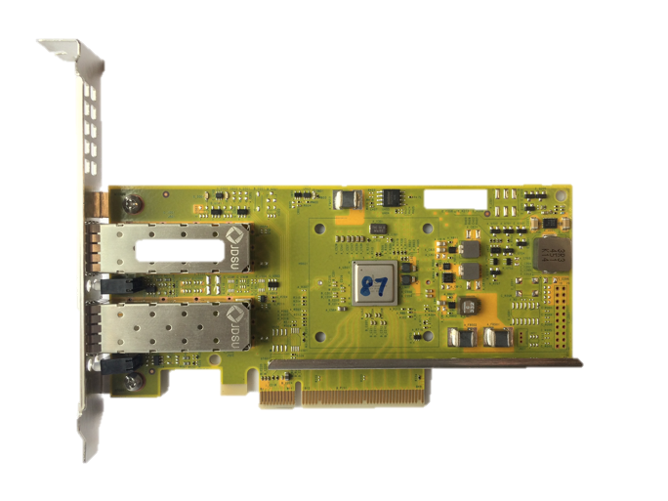
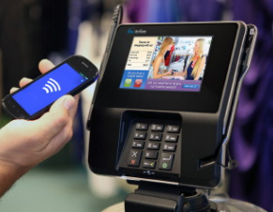
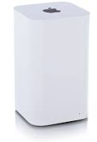

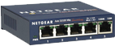
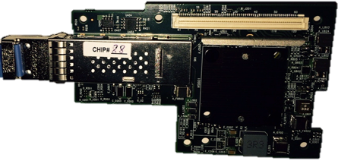
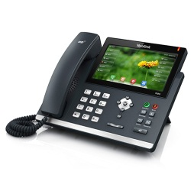

CCX Charter - FY2016 Revenue ($915M)
Compute Endpoints and Connectivity
Controller
StrataGX™ CPUs
Knowledge
Based Processors
ROBO™ Small Switches
KBP
Market leading Ethernet NIC
Enterprise and Cloud
Point-of-sale, Enterprise VoIP, Client Security, Control Plane
#1 market share
20 yrs of R&D w/400 patents
#1 Home, SMB, retail Ethernet
Integrated in SoCs

Slide 5
CCX Marketing Organization - Summary
Dan Harding
Robert Lusinsky
Gady Rosenfeld
Eliot Rosen
Rex Kiang
Raj Krishnaswamy
Sarada Sundar
All Controller and Stingray in-bound
Ethernet Ctrl outbound at Tier 1 OEMs (Dell, HPE, Lenovo)
OneConnect (legacy)
Client controller
Ethernet Controller Outbound
All end-users (Cloud, financial, Telco’s)
Tier 2 server OEMs
Network OEMs
ODMs
SBX (legacy)
All storage engagements with Stingray
MIPS (legacy)
StrataGX
All Inbound & outbound
Avani Amin
Daniel Kim
Marketing operations & planning across CCX
KBP
Robo
All inbound & outbound
StrataGX™ Embedded Processors
KBP & Robo Ethernet
Data Center – Ethernet Controller & Ethernet Storage

Slide 6
CCX Marketing Organization
KBP™ & Robo™ Ethernet
Data Center – Ethernet Controller & Ethernet Storage
StrataGX™
Robert Lusinsky
Gady Rosenfeld
Eliot Rosen
Rex Kiang
Raj Krishnaswamy
George Webb
HPE, Lenevo
Apple (client)
David Vieira
Outbound: Dell
Inbound: Stingray
Carl Tung
Inbound: Software
Inbound: Stratus
NX1
Jongpil Lee
Inbound: Cu, Cu+, Wh+ (Si & boards)
Inbound: Thor
Telco’s
GOOG, MSFT, AMZN
CDNs (Netflix . . )
Apple
SBX (legacy)
Facebook, Oracle, IBM
Web2.0 end users
Financial end users
Eric Yeh
Tier 2 Server OEMs
ODMs
Network OEMs
Alex Chu
China Cloud and Telco
Stingray for storage OEMs / ODMs
Stingray with end-users (storage only)
MIPS (legacy)
Laurent Hendrichs
VoIP
Comms
Todd Trammel
Point-of-sale
Client Security
Steve McIntyre
Wireless Audio
Embedded Channel
Satya Simha
Comms – Inbound /Outbound
Rakesh Agrawal
Embedded: Inbound
Zaheer Kasad
KBP (CSCO, ANET, ALU)
Robo
Pramod Gollapudi
KBP (APAC/EMEA)
Jim McDermott
KBP (NA)
Inbound: KBP
Asaf Henig
Inbound: Robo
Robo channel (NA/EU)
ZQ MA
Robo APAC

Slide 7

StrataGX CPU’s in Various Networking Applications
Wireless Infra
Service Provider Network
LTE eNodeB
Carrier Ethernet Access
Carrier
Ethernet Aggregation
Carrier Ethernet Core
Data Center
Enterprise and Carrier Wi-Fi Access Points
Carrier
Wi-Fi
TOR
IP Router
Backhaul
Premises
Central Office
vCPE
vOLT
Metro Access
Metro Aggregation
vE-CPE
Retail Router
Residential
Advanced
Gateway
Internet Core
Branch Office
Firewall/
SD-WAN
Switch Control Plane
StrataGX Family of 32-bit / 64-bit CPU’s in Service Provider/Carrier Designs

Slide 8

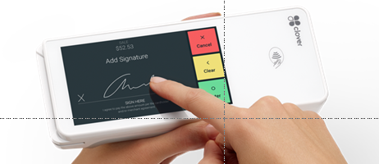
Product Line Updates
StrataGX Product Family
Stringray (5873x) sampling now
Persona Extreme – Available @ 1.6GHz for VOIP
All QR/Barcode skus sampling this quarter- Cygnus Q (now); 5892Q (June), LynxQ (July)
Merlyn
Product
Stingray
NS2
8x A72
Omega
4x A57
Merlyn
2x A53
NS
2x A9
Performance
2x A9
PE 1.6
P. Extrme
Cygnus+
Cygnus
1x A9
Persona
1x A9
Claudius
1x ARM11
Lynx
1x ARM11
1x M3
Verifone – 4 yr ($100M+) strategic supplier agreement
Huawei – PE / Omega IP phone design win
Netgear – Won NS retail router model for Costco
Clover launches Lynx-based Flex Portable POS
IP telephony growth driven by cloud service providers (hosted services) and China
Fingerprint innovation driving need for much higher performance (M-class → A-class)
Sales
Market

Slide 9

StrataGX Roadmap
Production
Sampling
Design
Concept
Multi-Core
Control Plane
16x A72+, 3.0GHz
100G/50G, 25G
100Gb Crypto
Control Plane
8x A72, 3.0GHz
50G, 25G/10G
50Gb Crypto
SR2
Stingray
Control Plane, Router
4x A57, 2.2GHz
10G/5G/2.5G Ethernet
16Gb Crypto
Smart POS, VoIP, WA
4x A72, 1.5 GHz
4K Video / 3D GFX
HDMI, PCIe, GE
NS2
Cygnus2
Control Plane, Router
2x A9, 1.4GHz
GE Switch/PHY
2Gb Crypto
Northstar
5301x
NS+
5862x
VoIP, WA
2x A53, 1.4GHz
GE Switch/PHY Low Power
VOIP, WA
2x A9, 1.0GHz
1080p Video
2D/3D Graphics
Omega
Merlyn
Single Core
PoS, VoIP, WA
A9, 1.6GHz
PoS, VoIP, WA
A9, 1.25GHz
3D GFX, Security
Cygnus+
Client Security, POS
A7, 1GHz
Security, NFC
Cygnus
5830x
Citadel
Claudius
589x
Client Security, mPOS
M3, 250MHz
NFC, Security
Lynx
5810x
USH
588x
Current
2017
2018
2019

Slide 10


StrataGX Comms SoC
Control & Data Plane Processing
Target Customers
BCM58732
BCM58712
BCM58713
Stingray
BCM5862x
BCM5852x
NorthStar2
BCM53012
BCM53016
NorthStar+
Line Cards
Ent. Routers
SMB Routers
Microwave Backhaul
Service Providers
Ent. Switches
Data Centers
PPC to ARM
XLP to ARM
Using CSG Switches
NorthStar
3 GHz
2 GHz
1.4 GHz
1 GHz
5000 DMIPS
2-core Cortex-A9
Integrated Switch
Integrated PHYs
In Production
7000 DMIPS
2-core Cortex-A9
Integrated Switch
Integrated PHYs
2G Crypto
In Production
34,000 DMIPS
4-core Cortex-A57
10G XFI
16G Crypto
Hardware QoS
HW Virtualization
Production
120,000 DMIPS
8-core Cortex-A72
10G, 25G, 50G
90G Crypto
Hardware QoS
HW Virtualization
Sampling

Slide 11
Target Application – Control Plane Processing
Sell CPU as control/data plane processor for CSG switches
Host CPU
NorthStar2
4-core A57
DDR
Sample Customers
Target Switches
Flash
Brocade
Ericsson
ZTE
Nokia
Avenger
Firebolt5, Maverick
Tomahawk2
Trident2+
Qumran-AX
Ramon
RJ45 MGMT
SGMII
PCIe
Firebolt5
Collateral
Advantages
Documentation
Integrated Switch SDK
Pre-Tested w/ Broadcom switches
XMC Cards & Com Express
Easier sell
Trend to ARM CPU
Higher revenue
“Stickiness”
BCM64920
BCM84868
QSFP+
QSFP+
Most CSG switches are tested with NorthStar2
For very low competitive pricing, offer NorthStar

Slide 12
Why StrataGX CPU for Control and Data Plane Processing
FEATURES
Highest Speed ARM CPU in industry - 3.0GHz!
Hardware functions to assist in networking applications
Open Source, Upstreamed, DPDK /ODP supported software
Pre-integrated switch drivers
Pre-tested and Pre-qualified CPU with CSG switches
StrataGX ARM CPU
CSG Switch
Competitive: 8-cores used for comparison
BENEFITS
Enable control, data, and management partitioning in one chip
Accelerate packet processing and improve performance metrics
Bypass kernel with DPDK/ODP to increase software performance
Reduce design and qualification time with pre-integrated software
Improve time to market
 | StrataGX | NXP | Cavium
Max Freq | 3GHz | 2GHz | 2.4GHz
DMIPS | 120,000 | 89,440 | <35,000
Shared IP w/ CSG (10G, PCIe) |  | X | X
Pre-tested w/ CSG |  | X | X
Pre-qualified |  | X | X

Slide 13

Product Status and Technical Collateral – What’s New!
Silicon
Highest Frequency 3.0GHz 64-bit ARM Cortex-A72
Boards
DDR4 based evaluation boards, XMC cards, and Com Express cards
Software
Open Source, Upstreamed Linux, yocto, ubuntu, ODP and DPDK
Performance
Benchmark Availability, Comparisons with Intel
Documentation
Datasheets, Theory of Ops, Programming Guide, Hardware Design Guidelines

Slide 14



64-bit ARM CPUs: Broadcom vs. Competition
NXP
Marvell
Broadcom
Speed | 2GHz | 3GHz
Cores | 4 | 8
Crypto | 20G | 90G
Ethernet | 10G Only | 10G, 25G, 50G
LEAPS and BOUNDS AHEAD of Competition

Slide 15
Call To Action
$$$$
Sell Broadcom with Broadcom
Sell StrataGX with switch and PHY. Do not let Marvell win!
Focus on targeted applications
Control Plane, Router, Storage
Use Support Staff
Architects, Applications Engineers, Software
Enable “stickiness” with StrataGX
Software investment not easy to replace
StrataGX enable “sustainability”
Long life cycles 7 years or more, higher gross margins
$$

Slide 16
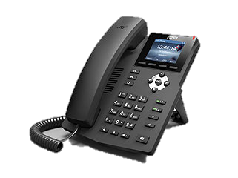
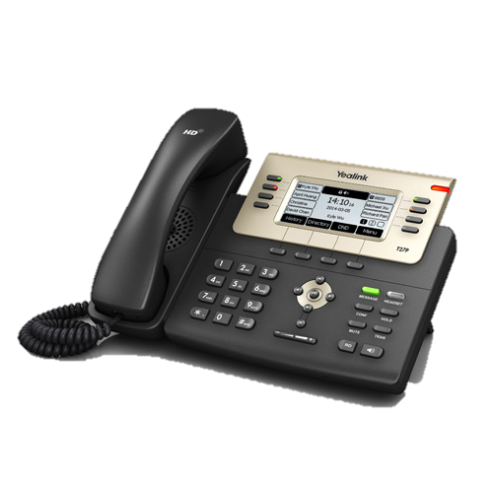
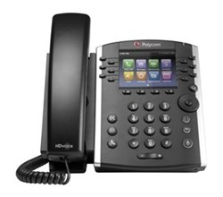
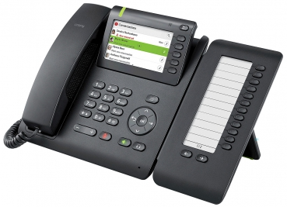
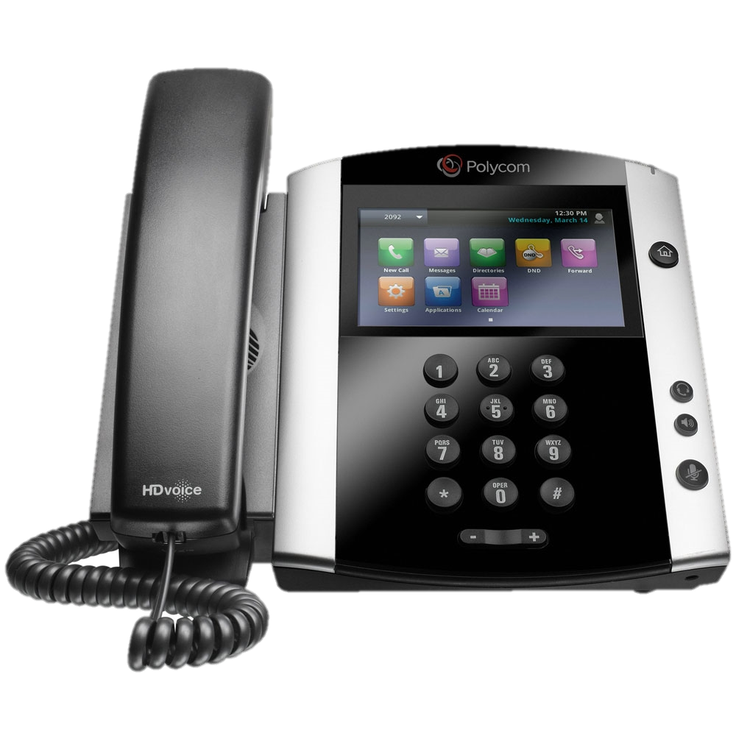
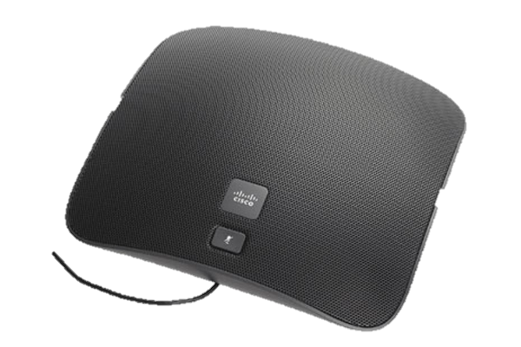
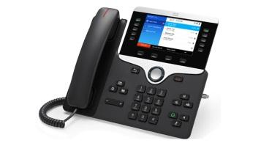
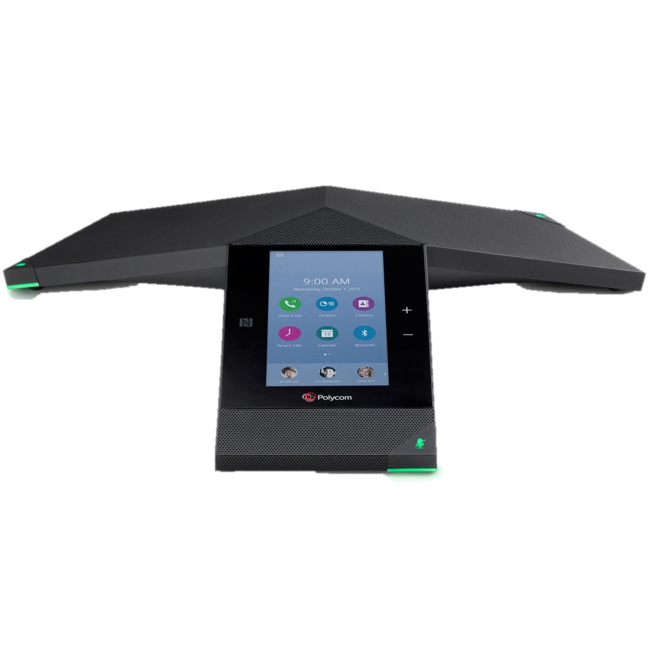
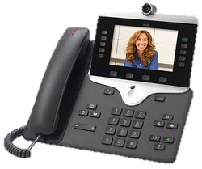
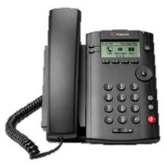
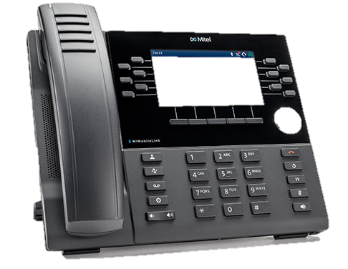
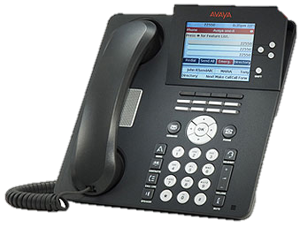


StrataGXTM Enterprise VoIP Solutions
#1
63% market share thanks to comprehensive silicon and software offering
Coming Soon
All around
desktop
High-end desktop
Huddle room conference
High-end desktop
Videophones
Conference phones
Low-end
1198
Persona
Value
Persona
Omega
Persona
Extreme
Merlyn
Call to action
Call to action
Competitive Update
Call to action
Competitive Update
Explore opportunities for smart speaker w/ VoIP
Broadcom ideally positioned thanks to complete software offering in audio and VoIP
Promote ODM solutions to tier 2/3 accounts
Broadcom ideally positioned thanks to complete software offering in audio and VoIP
Lead ODMs: Pegatron, Foxconn, Sercomm + more
DSP Group announced new “DVF 101” at CES 2017
Dual Cortex A9 with 3D GPU + integrated audio codec
DVF 101’s major shortcomings
Late to market. BRCM intro’d 2xA9 in 2013 (Merlyn).
All new BRCM SoCs are 64b.
No integrated switch: adds to BOM cost
Best devices to position vs DVF101: Merlyn and Omega
Explore opportunities for smart speaker w/ VoIP
Broadcom ideally positioned thanks to complete software offering in audio and VoIP
Promote ODM solutions to tier 2/3 accounts
Broadcom ideally positioned thanks to complete software offering in audio and VoIP
Lead ODMs: Pegatron, Foxconn, Sercomm + more
DSP Group aggressively promoting their processors at Broadcom accounts
DSPG desperate to grow revenue as Avaya’s future looks shaky
Promise dubious BOM cost reductions also achievable with Broadcom solutions – no innovation
Offer low cost, but outdated and inflexible ARM9 SoC
Look for growth in China
Local Chinese vendors ideally positioned to capitalize on regional growth
Be vigilant – Don’t lose to DSPG!
Call marketing if you sense competitive threat from DSPG

Slide 17


VoIP: Competitive positioning against DSPG
Notes
DSPG: Only low-end solutions in production
DSPG audio performance limited by outdated ARM926 implementation (all processors)
Performance
Better system cost with Broadcom thanks to Ethernet switch integration.
Request “Low cost design guidelines” from Mktg
System Cost
Brcm offers open, flexible ARM+Neon software
DSPG offers closed, micro coded, rigid implementation on ARM926
Audio software
Connectivity (WiFi/BT)
BRCM offers field hardened WiFi/BT in partnership with Cypress
Security
BRCM undisputed leader in security. No proven secure solution from DSPG.

Slide 18
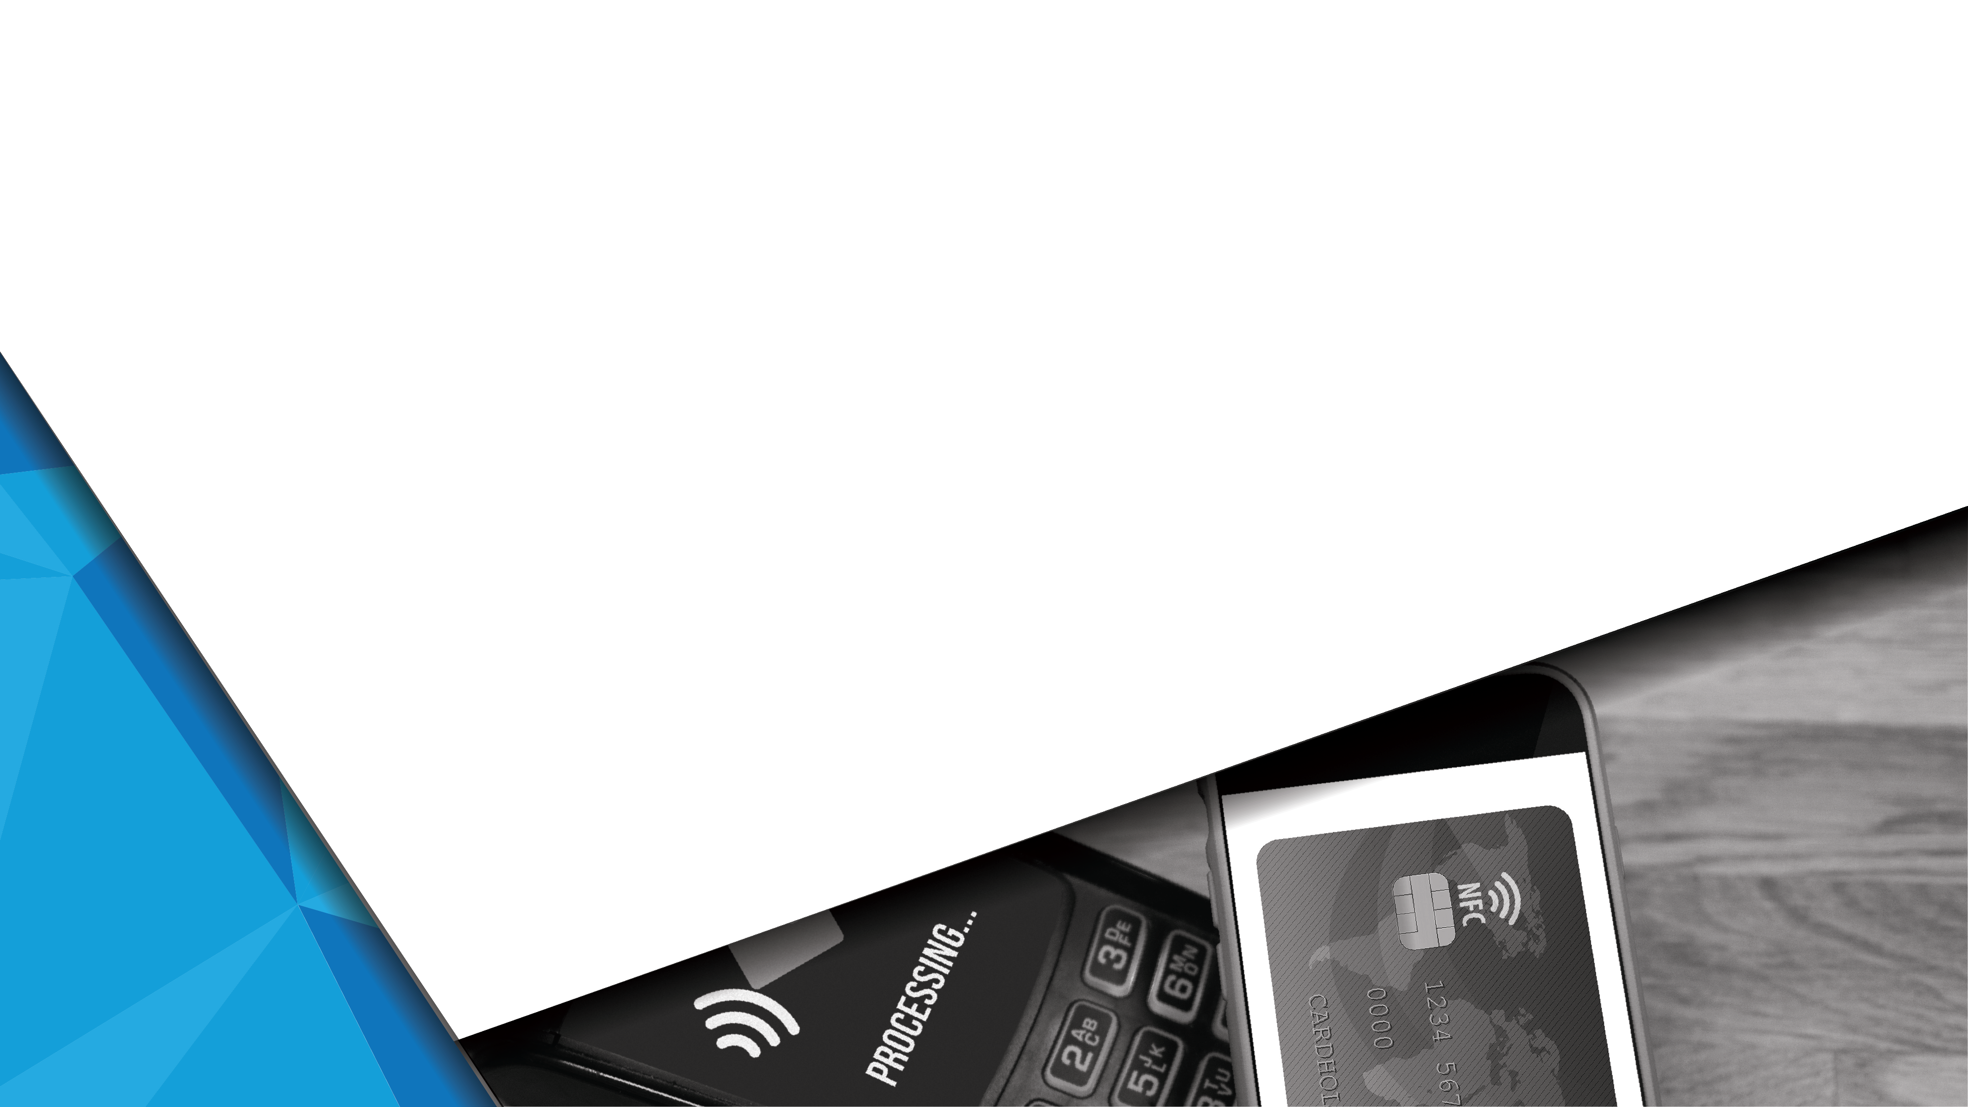


Broadcom / Code Corp POS “Q” Scanner Bundles
Cygnus BCM58302/303Q (Sampling Now)
High-end secure processor supports 2-5Mp resolution & the
flexibility of running Linux or Android
Claudius BCM5892Q (Sampling June)
Mid-range secure processor supports VGA resolution on Linux devices and includes a USB camera with EdgeDecoder barcode software for processing QR payment barcodes
Lynx BCM58101/103Q (Sampling July)
Small low-cost secure microcontroller supports two usage modes with integrated scanning license and payment security:
Standalone processor on RTOS supports VGA resolution camera
Co-processor alongside high-performance AP running scan software & high resolution camera on Android
Saves $20-50 vs hardware scanners without sacrificing performance or security

Slide 19



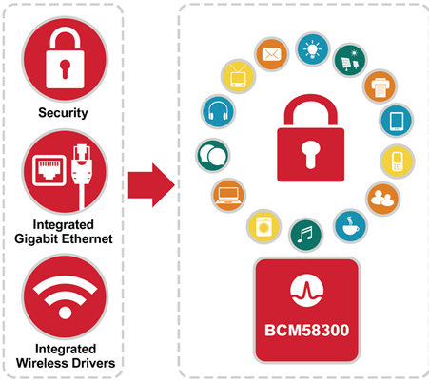
Wireless Audio / Embedded Applications
demo available Q4‘17 available now
voice demo available now
Key Embedded Positioning Points:
Security is critical to any new embedded design
StrataGX security leadership demonstrated with #1 POS market share
Highly integrated SOC featuring:
Best in class security
Gigabit Ethernet
Integrated wireless drivers
Flexible UI interfaces

Slide 20
Broadcom Wireless Audio Solution
June 2017

Slide 21
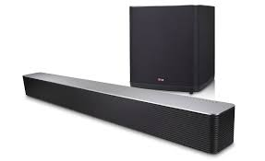
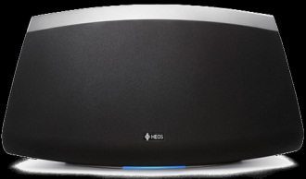
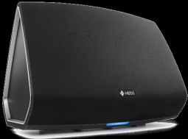
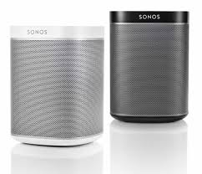
Wireless Audio Platform
Cygnus
Cortex A9 1.2GHz NEON
DDR3/LPDDR2, LCD
High Res Audio with 1 sample sync
Secure Boot, 2x GE MAC + PHY, USB 2.0
Cygnus Plus
1x Cortex A9 1.6GHz, NEON
DDR3/LPDDR2, LCD, 3D GFX
Dolby ATMOS
High Res Audio with 1 sample Sync
Secure Boot, GE MAC + PHY, PCIe
Sound bar, AVR,
HiFi Modules
43596
58305
43596
58306
Dual Band Concurrent WiFi 11ac 2x2 + BT4.2 + dLNA
Cygnus
Cortex A9 1.2 GHz NEON
DDR3/LPDDR2, LCD, High Res Audio
PCIe, SDIO, 1 sample sync, Secure Boot
GE MAC + PHY, USB 2.0
Cygnus Plus
1x Cortex A9 1.6GHz, NEON
DDR3/LPDDR2, LCD, 3D GFX
Dolby ATMOS
High Res Audio with 1 sample Sync
Secure Boot, GE MAC + PHY, PCIe
High Perf.
Wi-Fi Speaker
43596
58305
43596
58306
WiFi 11ac 2x2 + BT4.1
Cygnus
Cortex A9 1GHz NEON
DDR3/LPDDR2, LCD, High Res Audio
PCIe, SDIO, 1 sample sync, Secure Boot
GE MAC + PHY, USB 2.0
Mid Range
Wi-Fi/BT Speaker
43455
58305
WiFi 11ac 1x1 + BT4.1
Cygnus
Cortex A9 800MHz NEON
DDR3/LPDDR2, LCD, High Res Audio
PCIe, SDIO, 1 sample Sync, Secure Boot
GE MAC + PHY, USB 2.0
Low Cost
WiFi Speaker
58305
43438
WiFi 11n + BT4.1
2016
2017
2018

Slide 22
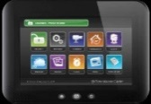


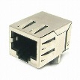
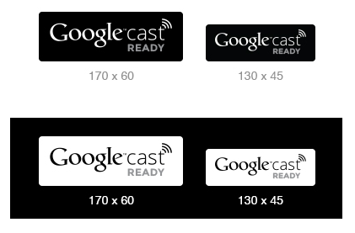

Cygnus Wireless Audio Solution
High-performance CPU
ARM Cortex A9 up to 1.25 GHz (3,125 DMIPS)
NEON SIMD/VFP Support
28nm Process technology for lower power consumption
High Resolution Wireless Audio
3 I2S with 384kHz/24 bit
Synchronization Digital Timing Engine
<1 sample speaker synchronization with AVB technology
No limitation from interrupt latency
Market leading integration and system cost
Gigabit Ethernet switch/PHY
BroadSAFE Security for access & content control
Secure boot, user authentication and trusted execution
DRM compliant silicon and software
Reference software solution
Linux and Android BSPs
Airplay and GoogleCast streaming audio support
Package: 17x17 FCBGA
Display
Headphone
Speaker(s)
Security
Additional Interfaces
Crypto Accelerators
LCD
ADC
GPIO
Audio
I²S/ TDM (3)
T-RNG
OTP -NVM 2Kb
CPU Subsystem
Standard I/O
Secure Protection Logic
32K
(I)
32K (D)
256KB L2 cache
USB2.0 (2)
Memory
Controllers
Secure
Memory
Access
Unit
Cortex-A9
Up to 1.25GHz
Boot
ROM
256KB
PCIe (2)
BCM43596
DDR3 (L) LPDDR2
SDIO (2)
WiFi + BT
Neon
UART (3)
NAND
SRAM
256KB
Secure
Scratch RAM
Serial Flash
System
I²C (2)
Cortex
M0
DMU
PMU
LDO’s
SPI (3)
Ethernet
Debug
3-port 10/100/1000 Ethernet Switch
JTAG
PWM (4)
GE PHY
GE PHY
GigE

Slide 23
Cygnus Plus: 30% more powerful than Cygnus
Display
Headphone
Speaker(s)
High-performance CPU
ARM Cortex A9 1.6 GHz (4,000 DMIPS)
NEON SIMD/VFP Support
28nm Process technology for lower power consumption
3D Graphics engine
High Resolution Wireless Audio
3 I²S with 384kHz/24 bit
<1μs speaker synchronization with AVB technology
Market leading integration and system cost
Gigabit Ethernet switch/PHY
Integrated LDO’s
BroadSAFE Security for access and content control
Secure boot, user authentication and trusted execution
DRM compliant silicon and software
Complete platform solution
Cygnus plus family of 11ac/11n + BT combo radios
Security
Additional Interfaces
Crypto Accelerators
LCD
ADC
GPIO
Audio
I²S/ TDM (3)
T-RNG
OTP -NVM 2Kb
CPU Subsystem
Standard I/O
Secure Protection Logic
32K
(I)
32K (D)
256KB L2 cache
USB2.0 (2)
Memory
Controllers
Secure
Memory
Access
Unit
Cortex-A9
Up to 1.6GHz
Boot
ROM
256KB
PCIe (2)
BCM43596
DDR3 (L) LPDDR2
SDIO (2)
WiFi + BT
Neon
UART (3)
NAND
SRAM
256KB
Secure
Scratch RAM
Serial Flash
System
I²C (2)
Cortex
M0
DMU
PMU
LDO’s
SPI (3)
Ethernet
Debug
3-port 10/100/1000 Ethernet Switch
JTAG
PWM (4)
GE PHY
GE PHY
GigE
Full reuse of Cygnus SW, HW, Platform & Production process

Slide 24


Audio Software Roadmap
Features
Customer Benefits
Multi-channel
Audio Sync
Enables multi-channel audio (Stereo, home theater)
Superior technology to “software” alignment done by competition
Reduced noise
Improved echo cancelation
Cost reductions in plastics
Beam forming
Acoustic Echo Canceler
Improved audio experience
Wide-band and full-band audio
Takes advantage of higher CPU performance
AEC
Dolby/DTS
(Atmos)
Required for soundbars and high quality speakers
Cost savings via elimination of DSP

Slide 25
Audioxchange (AxC) – Wireless audio stack

Slide 26
Summary
Wireless Audio is a key focus market for Broadcom
Dedicated roadmap covering all market tiers
Broadcom SoCs are aligned with market trends
Single software for supporting different voice ecosystems (Google, Amazon)
Multi-channel audio (Dolby, Google Cast, Apple AirPlay)
BOM integration to reduce system cost
Tight wireless integration with Cypress
Significant market and partner traction
Multiple products from tier1 OEMs are in production using Cygnus
ODM modules covering all price range

Slide 27
IOT and Embedded Security

Slide 28
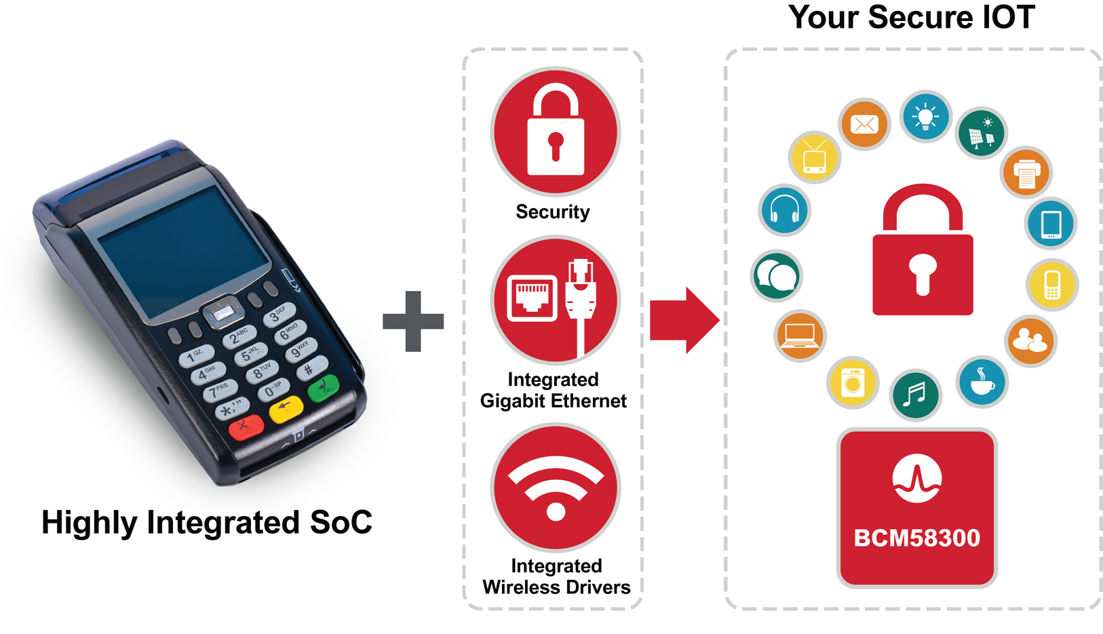
IOT and Embedded Payment Positioning
Key positioning points:
Security is critical to IOT
StrataGX security leadership
achieved #1 POS market share
Best in class security
High integration with flexible
UI interfaces
Gigabit Ethernet
Integrated wireless drivers

Slide 29
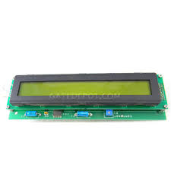
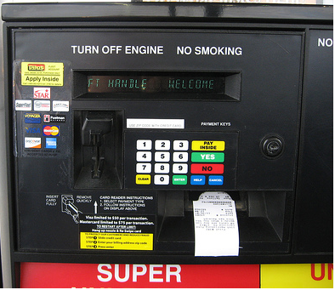
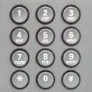
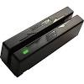
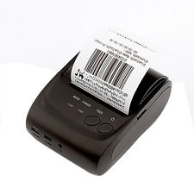
Lynx Gas Station - Embedded Security Solution
Security
System
System
Standard I/O
DMA
Timers
JTAG
UART (4)
Tamper Mesh
LDO
DMU
Trace
SPI (5)
Single Line Display
RTC with Alarm
SMBus (I2C)
Tamper Detect/Sensors
BBRAM 1280b
CPU Subsystem
PWM
MUX I/O
Cortex-M3
Up to 250MHz
Boot ROM 128KB
GPIO
Keypad
Crypto/PKA
SRAM i/f
T-RNG
USB-H
OTP -NVM 2Kb
Secure Protection Logic
MPU
USB-D
Magstripe Reader (MSR)
Secure Memory Access Unit
Data Acquisition
Card Readers
Smart Card
ADCs
Baud Rate
Receipt Printer
NFC
(Q)SPI NOR Flash Ctrl
512KB Scratch SRAM
Tone Encoder
MSR
Add USB Ethernet to communicate card approval info

Slide 30




Cygnus Gas Station Display and Networking
Display
Keypad
Camera
Speaker
Security
User Interface
Tamper Mesh
LCD
Touch
Screen
Camera
Keypad
I²S/ TDM (3)
RTC with Alarm
Tamper Detect/Sensors
BBRAM 1280b
WIFI /
BT
Crypto Accelerators
CPU Subsystem
Standard I/O
BCM4336
802.11n
T-RNG
OTP -NVM 2Kb
32K
(I)
32K (D)
256KB L2 cache
USB2.0 (3)
Secure Protection Logic
Memory
Controllers
Secure
Memory
Access
Unit
Cortex-A9
Up to 1.25GHz
Boot
ROM
256KB
SDIO (2)
DDR3 (L) LPDDR2
UART (5)
Neon
3D GFX
I²C (2)
NAND
SRAM
256KB
Secure
Scratch RAM
Receipt Printer
System
SPI (6)
Serial Flash
Cortex
M0
DMU
PMU
LDO’s
GPIO (167)
GigE
Ethernet
Reader
Debug
10/100/1000 MAC
Smart Cardx2
JTAG
PWM (6)
Magstripe Reader (MSR)
10/100/1000 PHY
Cygnus SOC adds wired/ WLAN networking, high end display & speaker

Slide 31

Parking Payment Station
Security
System
System
Standard I/O
Display
DMA
Timers
JTAG
UART (4)
Tamper mesh
Tamper Mesh
LDO
DMU
Trace
SPI (5)
RTC with Alarm
SMBus (I2C)
Tamper Detect/Sensors
BBRAM 1280b
CPU Subsystem
PWM
Keypad
MUX I/O
Cortex-M3
Up to 250MHz
Boot ROM 128KB
GPIO
Crypto/PKA
SRAM i/f
T-RNG
USB-H
OTP -NVM 2Kb
Magstripe
Reader
Secure Protection Logic
MPU
USB-D
Secure Memory Access Unit
Data Acquisition
Card Readers
Smart Card
Ticket
Printer
ADCs
Baud Rate
NFC
(Q)SPI NOR Flash Ctrl
512KB Scratch SRAM
Tone Encoder
MSR
Tamper detection / protection critical for unattended payment machines

Slide 32
Single Chip Parking Payment Station with integrated networking
Display
Security
User Interface
Tamper mesh
Tamper Mesh
LCD
Touch
Screen
Camera
Keypad
I²S/ TDM (3)
RTC with Alarm
Tamper Detect/Sensors
BBRAM 1280b
Crypto Accelerators
CPU Subsystem
Standard I/O
T-RNG
Keypad
OTP -NVM 2Kb
32K
(I)
32K (D)
256KB L2 cache
USB2.0 (3)
Secure Protection Logic
Memory
Controllers
Secure
Memory
Access
Unit
Boot
ROM
256KB
SDIO (2)
WIFI /
BT
Cortex-A9
Up to 1.25GHz
BCM4336
802.11n
DDR3 (L) LPDDR2
UART (5)
Neon
3D GFX
I²C (2)
optional
wireless
Magstripe
Reader
NAND
SRAM
256KB
Secure
Scratch RAM
System
SPI (6)
Serial Flash
Cortex
M0
DMU
PMU
LDO’s
GPIO (167)
Ticket
Printer
GigE
Ethernet
Reader
Debug
10/100/1000 MAC
Smart Cardx2
JTAG
PWM (6)
10/100/1000 PHY
Tamper detection / protection critical for unattended payment machines

Slide 33



Lynx Secure Entry Solution with Two Factor Authentication
Security
System
System
Standard I/O
2
Second Factor Authentication
biometric input such as fingerprint reader
PIN input using Keypad/display.
DMA
Timers
JTAG
UART (4)
Biometric Input
Tamper Mesh
LDO
DMU
Trace
SPI (5)
RTC with Alarm
SMBus (I2C)
Tamper Detect/Sensors
Single Line Display
BBRAM 1280b
CPU Subsystem
PWM
MUX I/O
Cortex-M3
Up to 250MHz
Boot ROM 128KB
GPIO
Crypto/PKA
SRAM i/f
T-RNG
USB-H
OTP -NVM 2Kb
Keypad
Secure Protection Logic
MPU
USB-D
Secure Memory Access Unit
Data Acquisition
Card Readers
1
Primary Authentication w/ Card
Contact or contactless support integrated
Smart Card
ADCs
Baud Rate
Contacted SmartCard
NFC
(Q)SPI NOR Flash Ctrl
512KB Scratch SRAM
Tone Encoder
MSR
NFC/ Contactless SmartCard

Slide 34

Cygnus Secure Entry Solution with Two Factor Authentication
Display
Speaker
Microphone
Camera
3 Backup / optional video verification
Security
User Interface
2
Second Factor Authentication
biometric input such as fingerprint reader
PIN input using Keypad/display.
Tamper Mesh
LCD
Touch
Screen
Camera
Keypad
I²S/ TDM (3)
RTC with Alarm
Tamper Detect/Sensors
Keypad
BBRAM 1280b
Crypto Accelerators
CPU Subsystem
Standard I/O
T-RNG
OTP -NVM 2Kb
32K
(I)
32K (D)
256KB L2 cache
USB2.0 (3)
Secure Protection Logic
Memory
Controllers
Secure
Memory
Access
Unit
Cortex-A9
Up to 1.25GHz
Boot
ROM
256KB
SDIO (2)
Biometric Input
DDR3 (L) LPDDR2
UART (5)
Neon
3D GFX
I²C (2)
NAND
SRAM
256KB
Secure
Scratch RAM
WIFI /
BT
BCM4336
802.11n
System
SPI (6)
Serial Flash
Cortex
M0
DMU
PMU
LDO’s
GPIO (167)
GigE
Ethernet
Reader
Debug
10/100/1000 MAC
Smart Cardx2
JTAG
PWM (6)
10/100/1000 PHY
1 Primary Authentication w/ Card
NFC/Contactless SmartCard
Contacted SmartCard

Slide 35
Summary
Leverage StrataGX success in POS to win “Secure IOT” and embedded payment opportunities
Identify applications with payment and security needs similar to POS
Beverage vending machines
Parking payment systems and meters
Transportation tickets
Gas stations
Secure entry
Emphasize strong communications integration
Gigabit Ethernet on-chip
Wireless drivers

Slide 36
StrataGX – Key Takeaways
Communications – Focus on NS2 for control plane
Promote full BRCM solution: StrataGX + XGS/Dune Switches
Security – Aggressively push Q-versions of Cygnus, Claudius, and Lynx
SW bundle with Code Corp increases revenue & design “stickiness”
Wireless Audio
Demo Dolby Atmos to audio customers.
VOIP
Don’t lose to DSPG!
Focus on China. Win designs with local vendors.
Notes:
Highlight the industrial, synergy in new Broadcom

